Slide 1
Ready for the Midterm?

Slide 2
Compute the following addition in binary representation where the second addend is 0011:
-0.25 + 0.375
1110 (carry)
1110
+ 0011
0001
0.125

Slide 3
Compute the following binary multiplication where multiplicand and multiplier are represented using 4 bits:
13 x 14
182
 |  |  |  | 1 | 1 | 0 | 1
 |  |  |  | 1 | 1 | 1 | 0
 |  |  |  | 0 | 0 | 0 | 0
 |  |  | 1 | 1 | 0 | 1
 |  | 1 | 1 | 0 | 1
 | 1 | 1 | 0 | 1
1 | 0 | 1 | 1 | 0 | 1 | 1 | 0

Slide 4
int function(int a)
{
return 3*a+5;
}
int main()
{
int x=5;
int y;
y = function(x);
...

Slide 5
fun: # This function overwrites $s0 and $s1
addi $sp, $sp, –8 # adjust stack to make room for 2 items
sw $s1, 4($sp) # save register $t0 for use afterwards
sw $s0, 0($sp) # save register $s0 for use afterwards
li $s0, 3
mul $s1,$s0,$a0 # s1 = 3*$a0 (3*a)
addi $s1,$s1,5 # 3*a+5
add $v0,$s1, $zero
lw $s0, 0($sp) # restore register $s0 for caller
lw $s1, 4($sp) # restore register $t0 for caller
addi $sp,$sp,8 # adjust stack to delete 3 items
jr $ra # Jump to addr stored in $ra
main: # x is $s0, y is $s1
add $a0, $s0, $zero # Argument 1: x ($s0)
jal fun # Save current PC in $ra, and jump to fun
add $s1, $v0, $zero # Return value saved in $v0. This is y ($s1)

Slide 6
Write MIPS assembly code that compute this expression:
B[3] = a + B[7]
assume that the base address of the array B is in $s1, 'a' is assigned to $s0, and assume that each array element accessed is in word size.
lw $t0, 28($s1) #B[7]
add $t0, $s0, $t0 #a+B[7]
sw $t0, 12($s1) #a+B[7] -> B[3]

Slide 7
Write the MIPS assembly code that isolate the first 4 bits of the value contained in register $s1
andi $t0, $s1, 15
#15₁₀ = 1111₂, isolated 1st 4 bits are stored in $t0

Slide 8

If these registers contain:
$t0 = 4₁₀
$t1 = 2₁₀
What is the value of $t2 after this instruction?
sll $t2, $t0, 4
$2^{4} = 16$, and thus $4∗16=64−>$$t2

Slide 9
If these registers contain:
$t0 = 4₁₀
$t1 = 2₁₀
Starting from the values above, what is the value of $t2 after this instruction?
or $t2, $t2, $t1
64= 0100 0000₂
2= 0000 0010₂
$t2 is 0100 0010₂ =66

Slide 10
For the MIPS assembly instructions below, what is the corresponding C statement?
Assume that the variables f, g, h, i, and j are assigned to registers $s0, $s1, $s2, $s3, and $s4, respectively.
Assume that the base address of the arrays A and B are in registers $s6 and $s7, respectively.
sll $t0, $s0, 2 # $t0 = f * 4 add $t0, $s6, $t0 # $t0 = &A[f] sll $t1, $s1, 2 # $t1 = g * 4 add $t1, $s7, $t1 # $t1 = &B[g] lw $s0, 0($t0) # f = A[f] addi $t2, $t0, 4 lw $t0, 0($t2) add $t0, $t0, $s0 sw $t0, 0($t1)
B[g] = A[f] + A[f+1]

Slide 11
Which is the two's complement representation of the number -23 ?
11111111111111111111111111101001
11111111111111111111111111101111
11111111111111111111111111111001
11111111111111111111111111101000

Slide 12
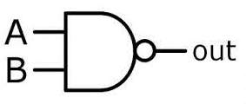
Can you use a NAND port to obtan the same behavior as an inverter?

Slide 13
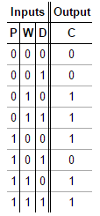

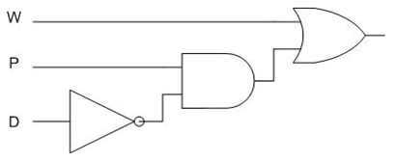

Slide 14
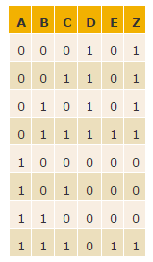
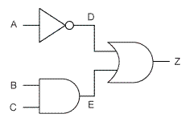

Slide 15
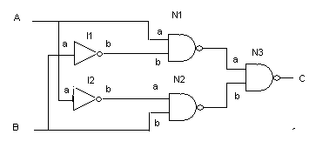
This gate outputs 1 if either input is 1 but not both (that is, it outputs 1 if the inputs are different)
Notes:
XOR

Slide 16
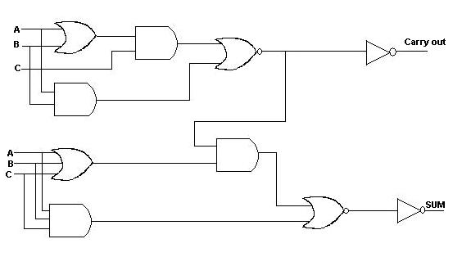
Notes:
This is a one bit fulladder, try to recreate the truth table

